Slide 1
.
Topic:-
{PLANT A TREE}
In this topic we have to make a site for ngo/rmc that if someone want to grow a plant or have free space in there locality they can contact ngo/rmc to grow a plant in there locality or surronding.

Slide 2
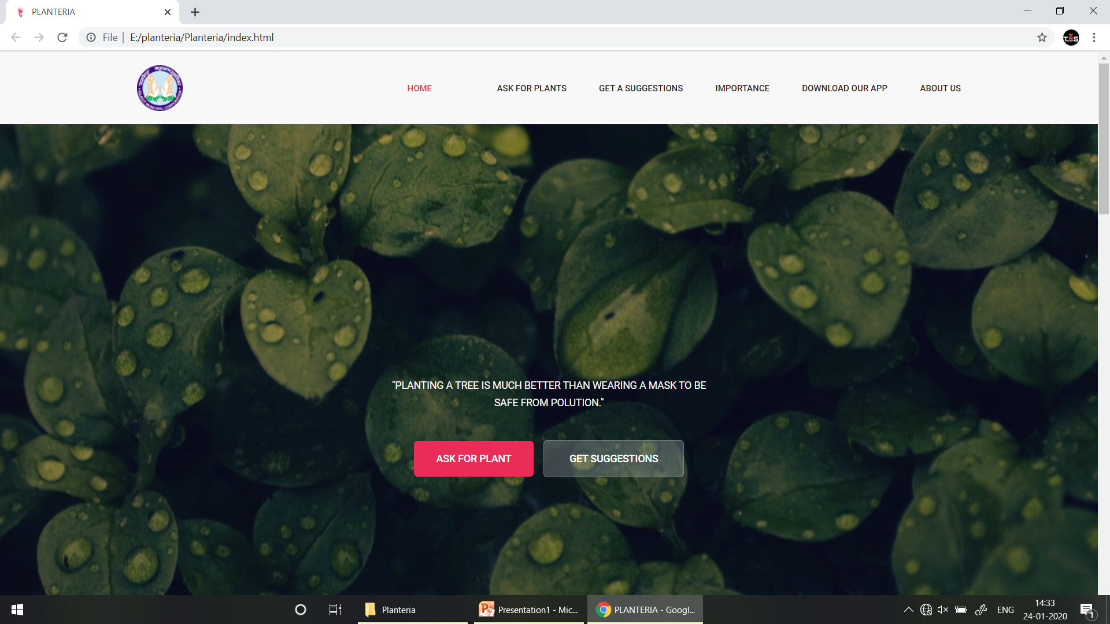
WEBSITE

Slide 3
“AWARNESS”
In this we tried to aware the people that if we don’t plant a tree now than in the upcoming future we may face the problems of getting impure oxygen or maybe no oxygen due to increase in industrial sector. So we tried to aware the people in various ways. We used more slogans which is visible everywhere and using some photos that what can we face in near or upcoming future.
We added a section of importance of trees where we told the importance where trees can be used and how much useful it is.

Slide 4
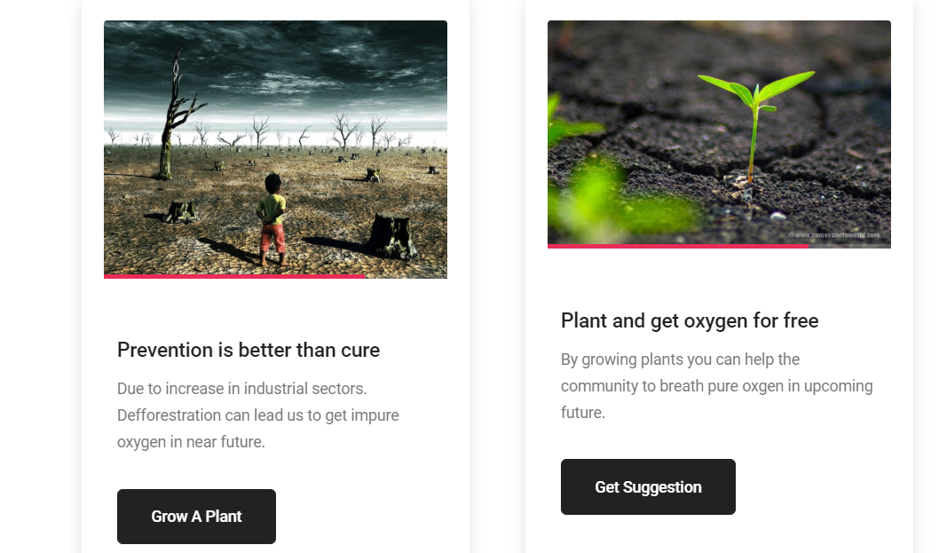
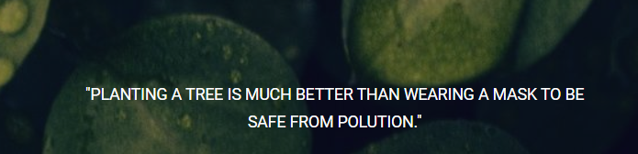
“Using slogans to aware”

Slide 5
“get a plant”
Thinking on the topic of that we have to take plant from ngo we added a get a plant option in our header which any user can click they have to fill a form. Where some information like address,name,etc is required and it will be sent to the officers or employers working in this field. We asked for the photo from the user from where they want to plant a tree. Which can give a clear view to officers about this. Which plant can be grown there in the locality.

Slide 6
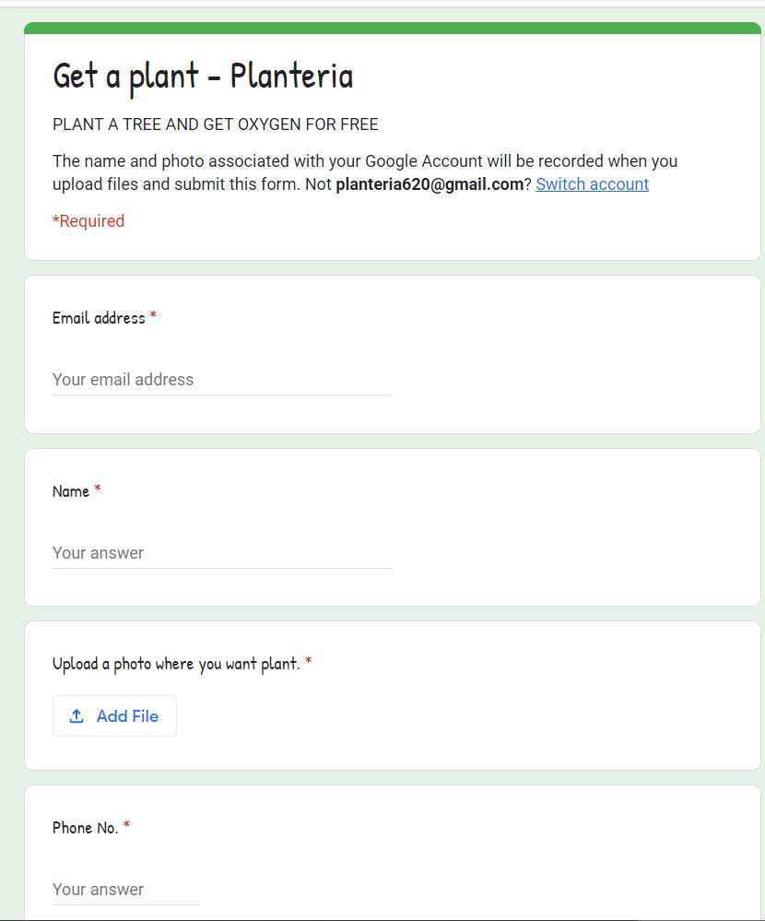
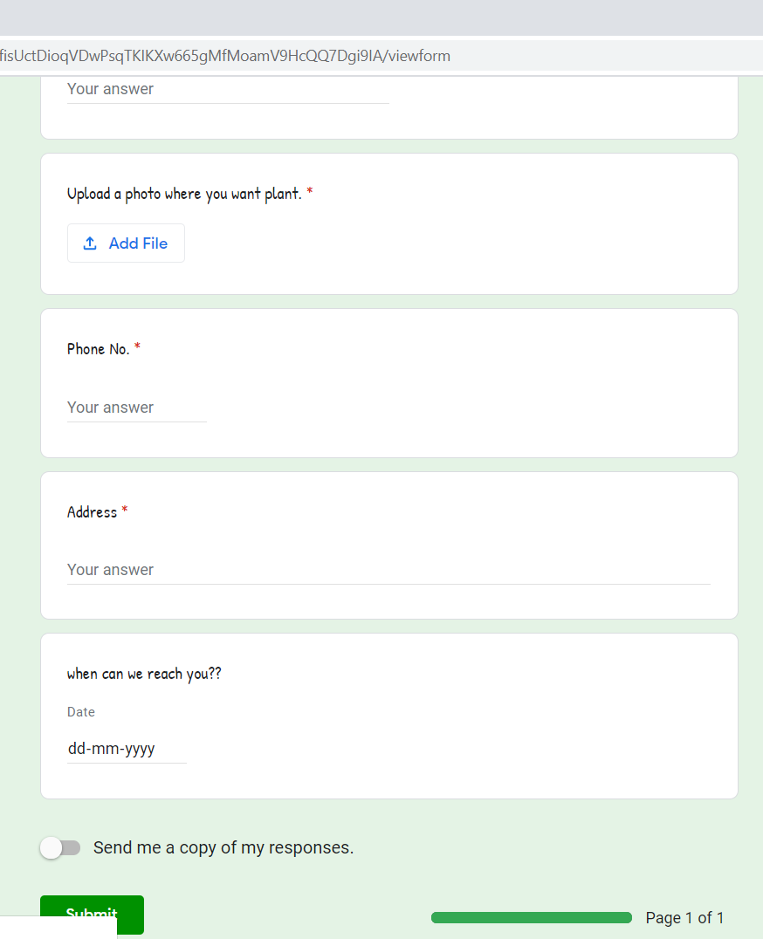
“FORM FOR THOSE WHO WANT PLANT”

Slide 7
“Get suggestions”
In this we added a more section which is get suggestions where user can get suggesitons from the botanists which are expert in this field. User will be asked for some information in the form. So where our officers can reach to them. So they can get a courage or clear idea that which can be grown in their locality,surrondings. And where plant can grow without any problem of water or soil,fertility.

Slide 8
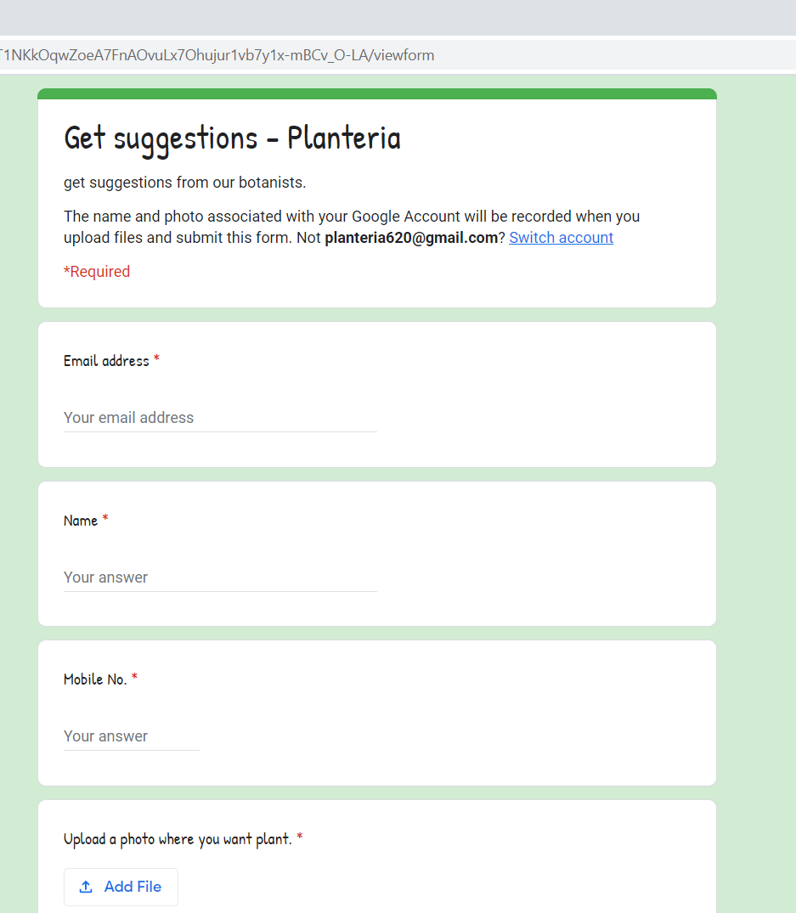
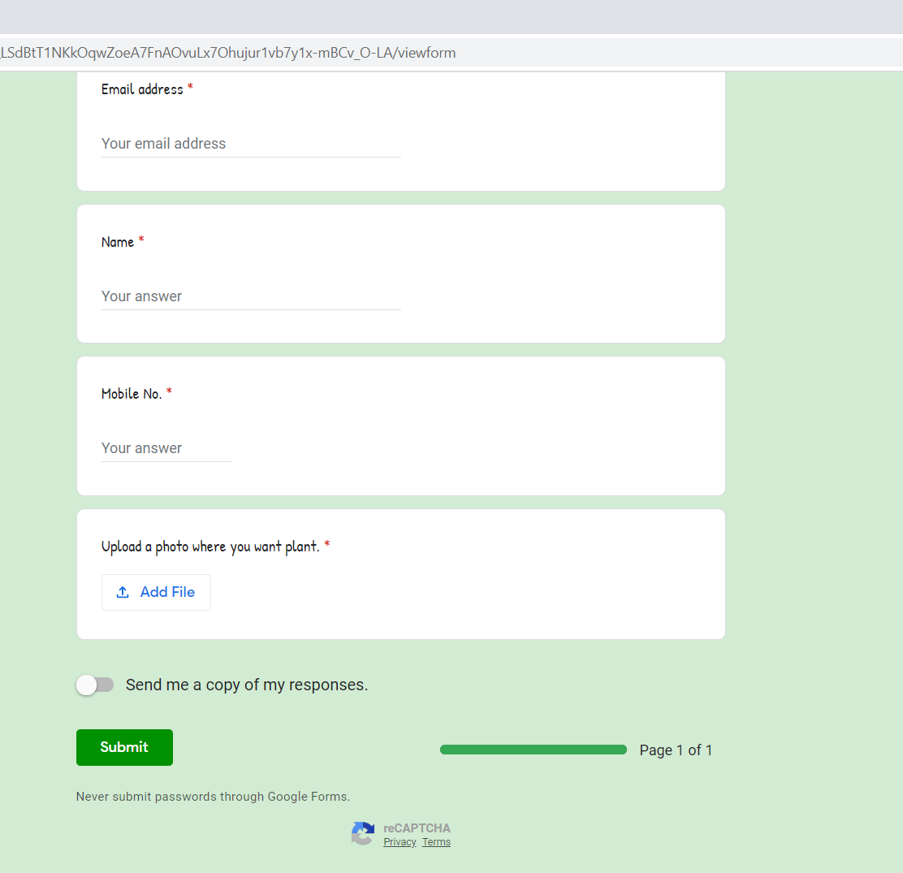
FORM FOR SUGGESTIONS

Slide 9
“importance of plants/tree”
We added a section of importance of trees where user can be awared that how much tree or plant is going to be important in upcoming future. We added various points there which are important in our day to day life and which can be used . Which can motivate user or people that how much plant or tree is going to be important or is important.

Slide 10
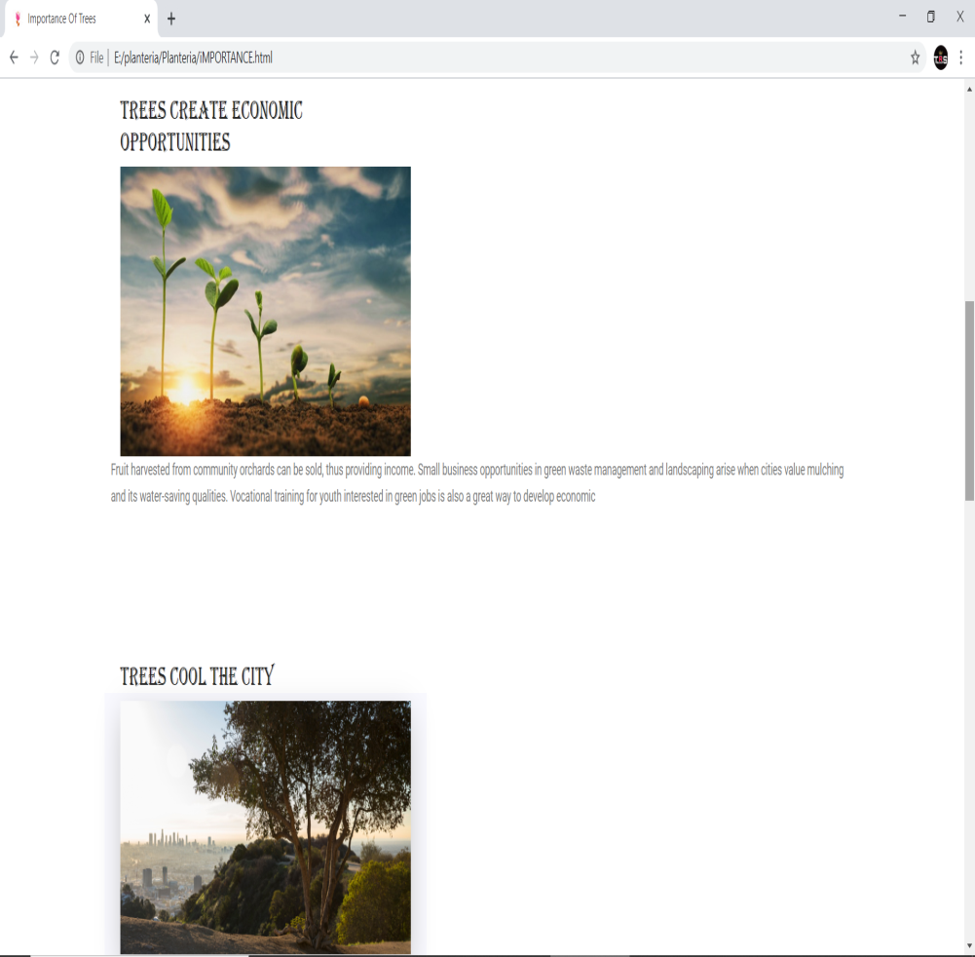
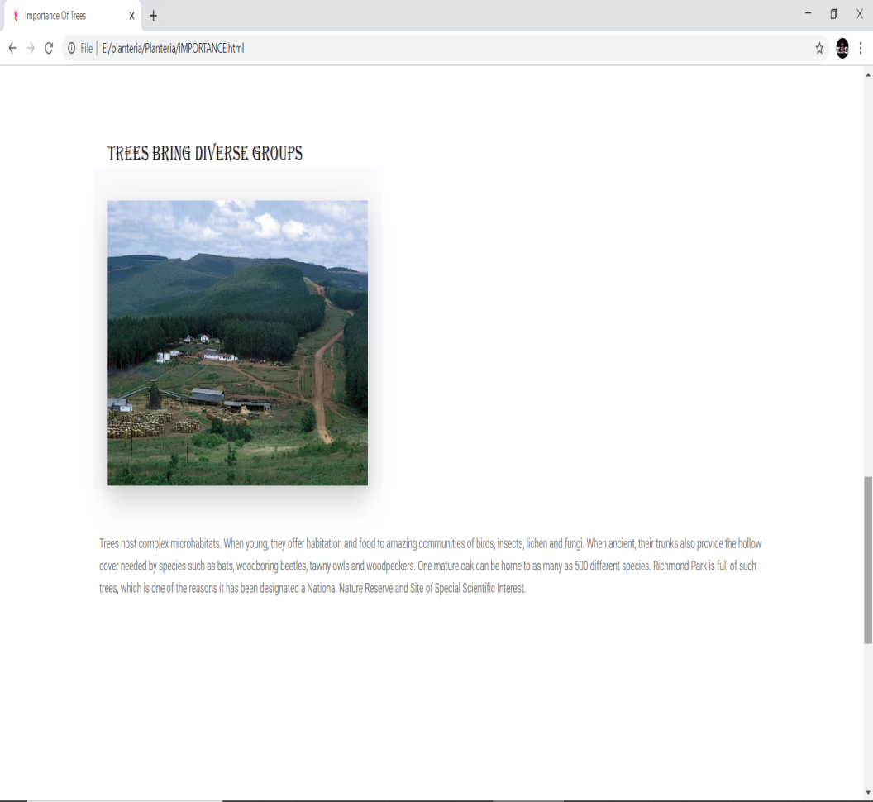
imPORTANCE OF PLANTS

Slide 11
Different platforms.
We published our idea on diffrent platforms where user can be compatible with and awarness can be increased. We used easy language and used more slogans and images because of which user can be awared about the situation which is going on. So different platfrom can gather much user and awarness can be increased much. In website we gave option to downlaod the android app of our project which is convinent to every user.

Slide 12
USING SPREADSHEET
We used spreadsheet where the data got from user can be stored there and because of which the corporate can clear the number of trees they grew in that month or data is infront of them.

Slide 13
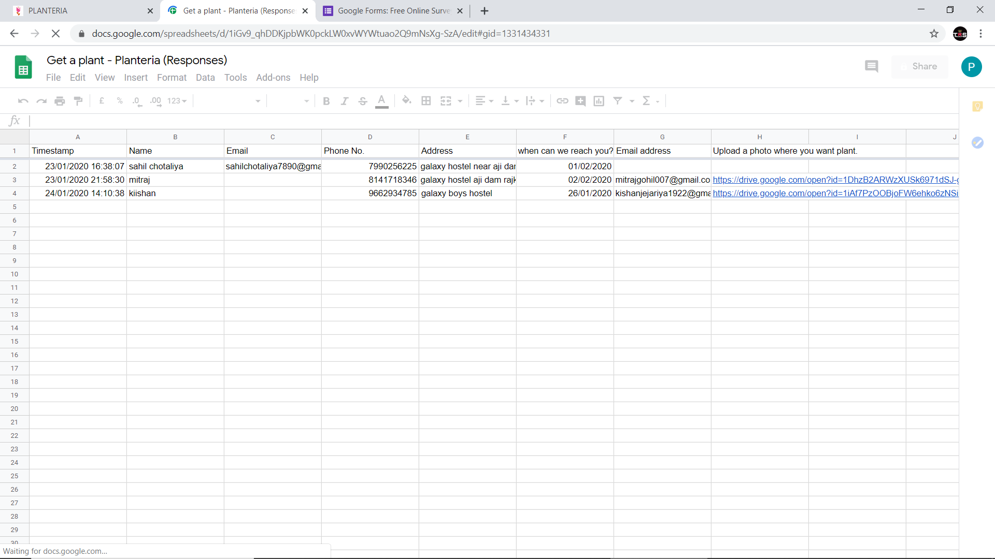
Screenshot of Spreadsheet

Slide 14
About us
This project is created by students of Government Polytechnic Rajkot.
Names of students working under this project are as follow:-
1)- Gajera Chintan
2)-Chotaliya Sahil
3)- Bariya meet
4)- Anil parmar
5)- Dholariya meet
6)- Kanani Bhargav
7)-Jejariya Kishan
8)-Siddhapura mohit

Slide 15
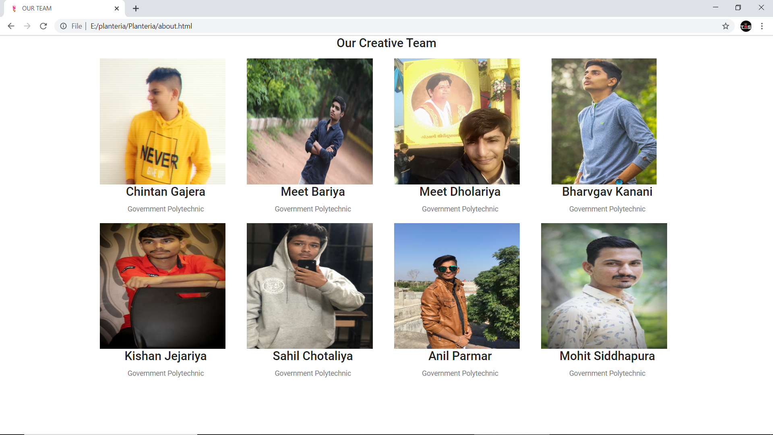
ABOUT US

